Slide 1
Lecture 1:
Introduction

Slide 2
Who we are
Instructor: Erik Learned-Miller Office hour(s): Thursday 3-4 https://people.cs.umass.edu/~elm/
TAs: Pia Bideau Hang Su SouYoung Jin
Office hours: See web page.

Slide 3
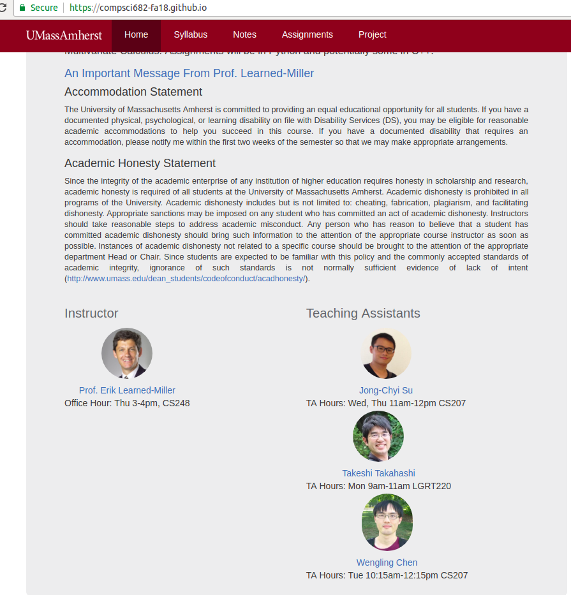
Course web page
https://compsci682-fa19.github.io/
OR …
Go to my web page (Google “Learned-Miller”)
Go to my teaching page
Click on top link

Slide 4
Optional Discussion Sections
Friday: 9:05-9:55 in CS 140
No discussion section this Friday
Will cover background topics such as:
Python techniques
slicing and broadcasting
Other parallelization techniques
Math techniques
Derivatives of vectors, matrices, etc.
Complex chain rule examples

Slide 5
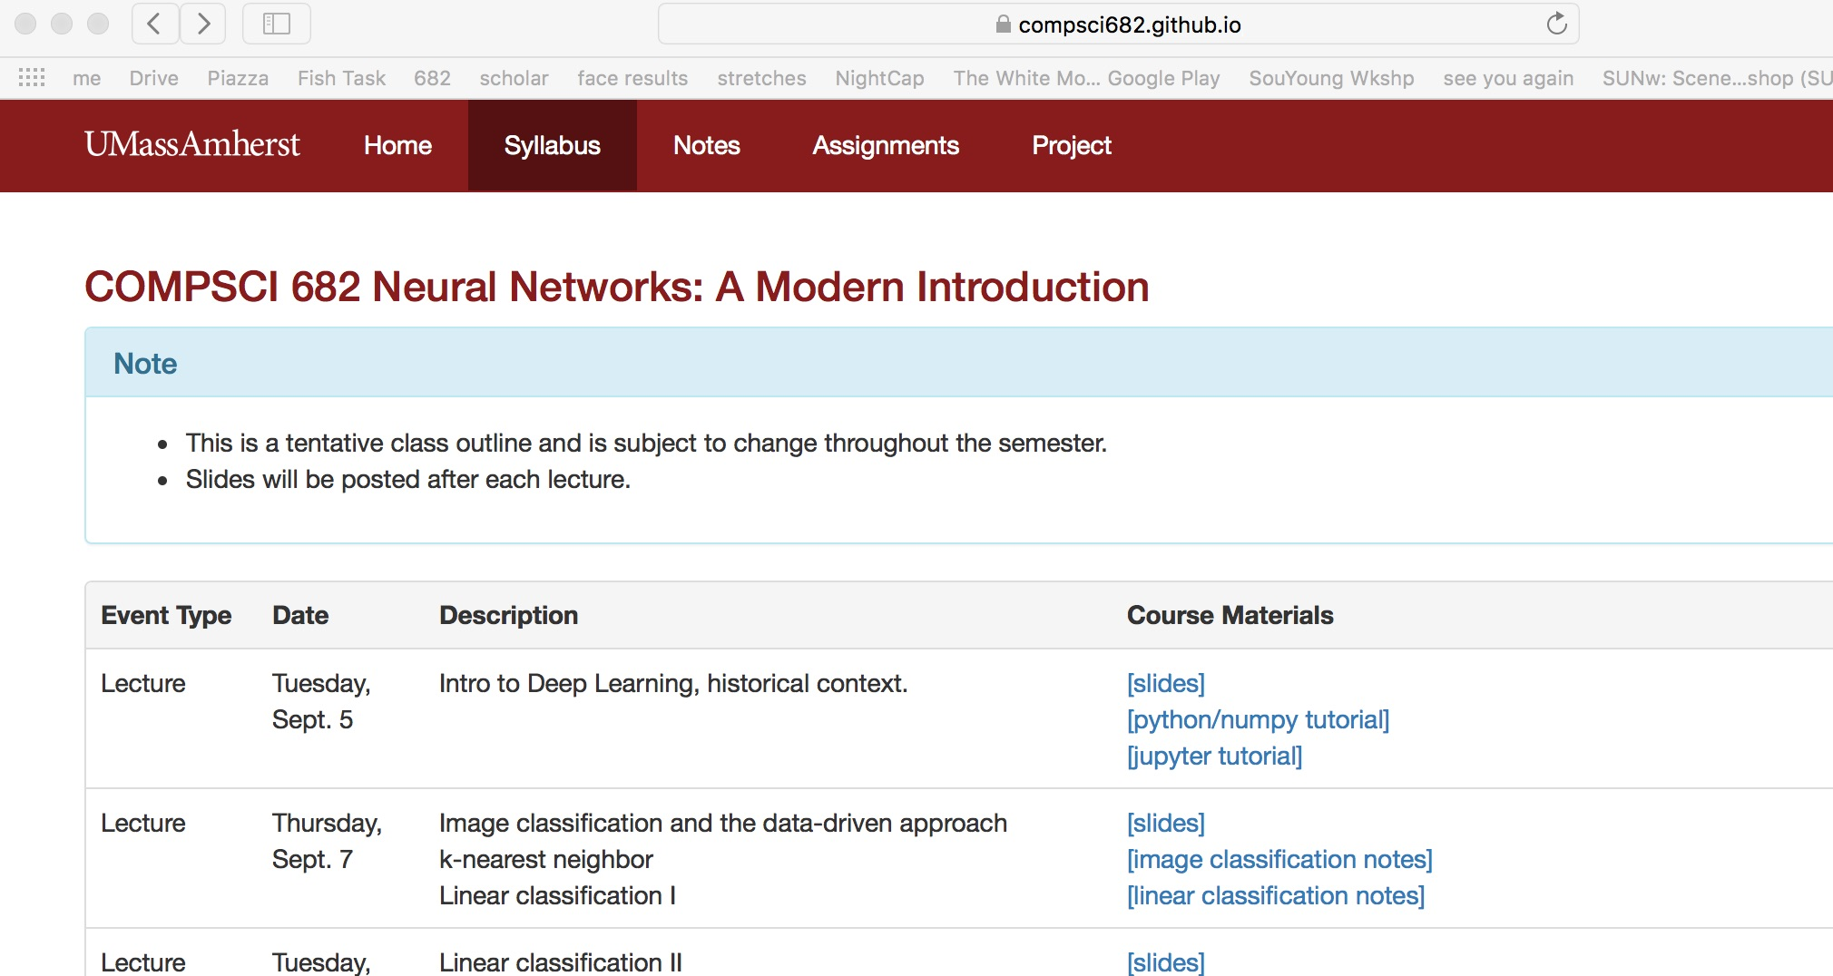

Slide 6
682 Neural Networks: A Modern Introduction
Topics: first half of the class.
Intro to supervised learning with K-Nearest neighbors
Support vector machines
Logistic regression for classification
Feed forward neural nets
Backpropagation
Batch normalization
Drop-out
Speed optimizations
Convolutional neural nets

Slide 7
682 Neural Networks: A Modern Introduction
Balance of theory vs. practice
Heavily tilted toward practice.
Examples:
Regularization will be used, but not much theory of it.
No proofs of convergence or optimality
Instead:
Develop applications “from scratch”
Build “layered” architectures from scratch so new models can be easily assembled
Implement popular add-ons such as batch normalization
Learn techniques for training and setting hyperparameters.

Slide 8
682 Neural Networks: A Modern Introduction
Applications
Mostly vision: Object recognition in particular.
However, can easily be applied to other domains.
You will learn what you need to know to apply neural nets broadly.

Slide 9
682 Neural Networks: A Modern Introduction
What this course is not:
General course on machine learning
General course on graphical models
Not even a general class on deep learning!!!
No Bayes Nets
No restricted Boltzmann machines or deep Boltzmann machines
Not a computer vision survey class
No tracking, stereo, depth estimation, etc., etc.

Slide 10
682:
Some motivational videos
https://www.youtube.com/watch?v=YyLhIPe96Ls https://www.youtube.com/watch?v=VOC3huqHrss

Slide 11
Course grades
3 Long Programming Assignments
Get started as soon as assignments are posted.
Some aspects of assignments require only basic knowledge of Python, but some require in-depth understanding of numpy arrays and complicated indexing schemes. They can take a while to work through.
If you don’t know Python, work through tutorial now.

Slide 12
Grading Policy
3 Problem sets: 15%*3 = 45%
Midterm exam: 15%
Final Course project: 40%
Milestone: 5%
Final write-up: 35%
Bonus points for exceptional poster presentation
1 Final project just accepted to NIPS (yesterday!).
Quizzes! Still deciding on this, but likely to occur. If so, will reduce percentage of everything else a little bit.
Late Policy:
7 free late days: use them as you see fit
Afterwards: 25% off per day late
Not accepted after 3 late days
Does not apply to final course project (must be on time)

Slide 13
Assignments
3 Long Assignments
Get started as soon as assignments are posted.
Some aspects of assignments require only basic knowledge of Python, but some require in-depth understanding of numpy arrays and complicated indexing schemes. They can take a while to work through.
If you don’t know Python, work through tutorial now.

Slide 14
Getting Started
Example: Mac
Language: Python
Instructions for installing given under first assignment instructions.
Development environment: Jupyter Notebook. Live code environment.
DEMO
Running a shell on the side: Jupyter QtConsole
Good for testing syntax, return values of functions.
DEMO

Slide 15

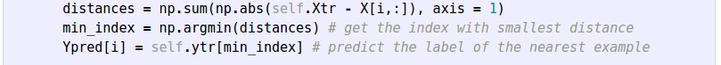
https://compsci682.github.io/notes/python-numpy-tutorial/

Slide 16
Assignment #1
Soon posted on course website
Due in 3 weeks (Sept. 25, 11:59pm).
It includes:
Write/train/evaluate a kNN classifier
Write/train/evaluate a Linear Classifier (SVM and Softmax)
Write/train/evaluate a 2-layer Neural Network (backpropagation!)
Requires writing numpy/Python code
Compute: Use your own laptops. Talk to me or TA if you don’t have your own computer.

Slide 17
Plagiarism and Cheating

Slide 18
Who, me?
Right now, cheating seems very far away.
Now imagine:
You just started homework due in 2 days. You realize it will take you a week.
You just had an internship interview where they asked you if you are getting an A in Neural Nets.
You have a midterm tomorrow and a project due in another class in one week.
You were just surfing the web for information on Python slicing and you bumped into a full solution to the current problem set. Perhaps I should just take a quick peek...

Slide 19
Don’t do it!!!!!!!!!!

Slide 20
Cheating last year
18 people were caught cheating last fall.
They were given penalties including
0 for the given assignment
An additional grade reduction for the class.
A filing with the Academic Dishonesty board.
Many people failed the class as a result.

Slide 21
UMass Culture
If you cheat, you put me and a lot of other people in an awful position:
If I let you off the hook, I am being completely unfair to people who actually did the work, and I’m promoting the idea that it’s ok.
If I punish you, I feel like a jerk, and you think I’m a jerk.
The bottom line is, there is no good way to come out feeling good about a cheating incident. It creates massive stress between faculty and students. Please don’t do it!

Slide 22
Advice
Everyone knows you’re not supposed to cheat.
What people don’t know is what you’re supposed to do when you’re desperate. Here’s some advice:
If you’re overloaded in the middle of the semester, consider dropping a class. Hopefully you can drop it without a “W”, but even a “W” is a lot better than an “F” and a record of cheating. A “W” will not influence your grade point average.
Take a “0” on part of the problem set. Many people who did not do part of one problem set got an A-. Some people missed a whole problem set and still got a B for the course.

Slide 23
5 Rules: What is cheating?
Let’s start with an easy one. Don’t copy any piece of the solution of any problem.
Never look at solutions to any of the homework problems. Most people who were caught cheating last semester claimed that they only “looked at” on-line solutions. This is NOT ALLOWED.
Do not look at discussions of the homework problems. These are likely to include methods for solving parts of the problem, which is cheating.
Don’t look up pieces of the problem on Google. For example:
“Computing the derivative of softmax”
“Gradient updates for the multi-class SVM loss”. Once you’ve done the search, you cheated. You are likely to see something you cannot forget. You can’t “unsee” the answer once you’ve seen it.
Common sense. If you look at something on the web and it made the problem easier, then you’re probably cheating. To be safe, stick to class materials, TAs, and Professor.

Slide 24
Questions about what is allowed
Question: Can I work with other students on the homeworks? Answer: No. Do the homeworks yourself.
Question: Where can I get help?
Look at the course notes
Go to optional Friday sections
Talk to the TAs
Talk to the professor
Can I look at on-line materials that are not part of the course?
Basically no. If you look at something and it’s part of the solution, then you have cheated. So it’s dangerous to go surfing around. Stick to the materials on the course web site. If there is soemthing you want to look up, ask the TAs a question and we’ll try to put materials on the course web site if it’s appropirate.

Slide 25
Plagiarism
When you write your final report, there are two ways you can use material from other papers:
Use the general ideas from another paper with your own writing. You *cannot* copy text from another paper unless you use quotation marks. Example:
In his famous 1915 paper, Einstein introduced the theory of general relativity [Einstein, 1915].
Quote a specific passage, usually because of the exact way it is worded:
Einstein said, “God does not place dice with the universe.” [Einstein, 1958]

Slide 26
Plagiarism
You cannot copy sentences into your writing and justify by citing the paper. This is plagiarism, whether you cite it or not. If I Google a sentence in your paper that is not quoted, and I find it, that means you were plagiarising!
Final comment: If you don’t know whether something constitutes plagiarism or cheating, ASK! If you don’t ask, it will be too late.
OK…. now on to the fun stuff!

Slide 27
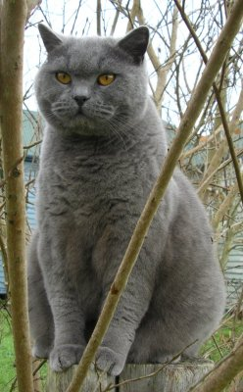
Image Classification: a core task in Computer Vision
(assume given set of discrete labels)
{dog, cat, truck, plane, ...}
cat

Slide 28

The problem:
semantic gap
Images are represented as 3D arrays of numbers, with integers between [0, 255].
E.g.
300 x 100 x 3
(3 for 3 color channels RGB)

Slide 29
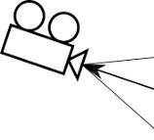
Challenges: Viewpoint Variation

Slide 30
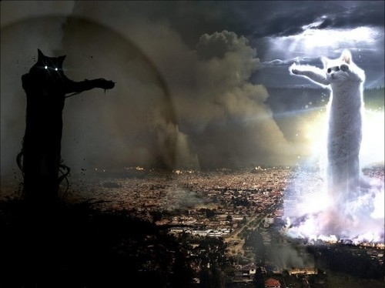
Challenges: Illumination

Slide 31

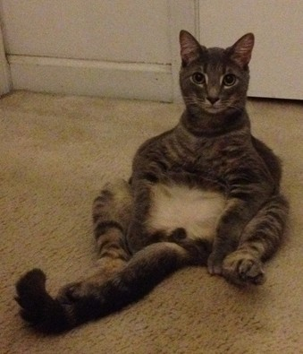
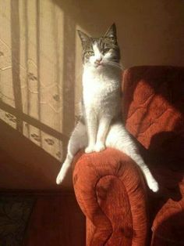

Challenges: Deformation

Slide 32
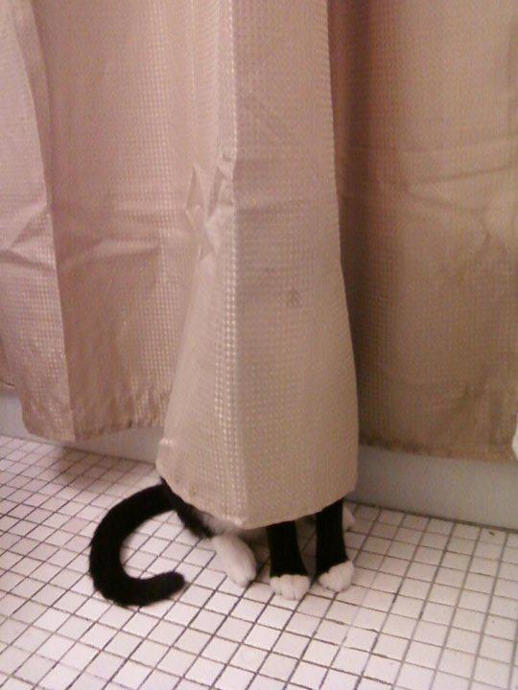
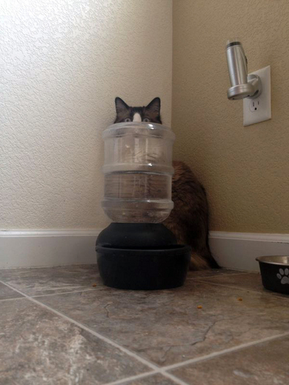
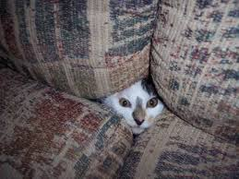
Challenges: Occlusion

Slide 33
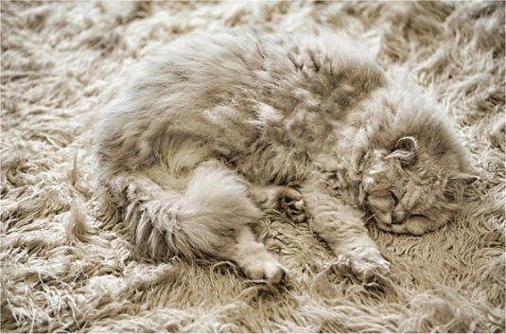
Challenges: Background clutter

Slide 34
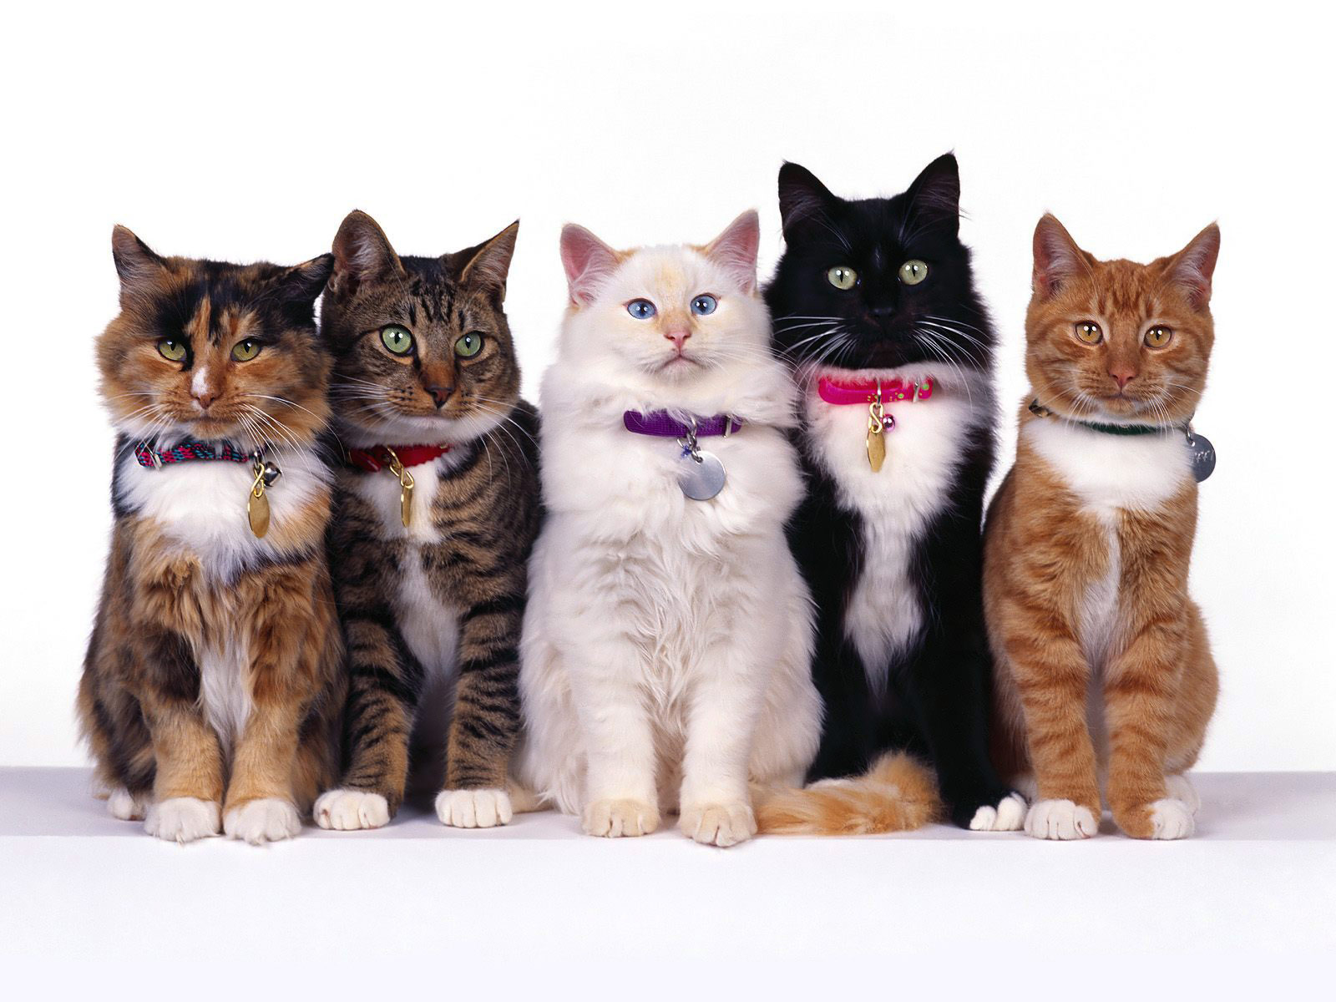
Challenges: Intraclass variation

Slide 35
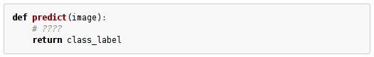
An image classifier
Unlike e.g. sorting a list of numbers,
no obvious way to hand-code the algorithm for recognizing a cat, or other classes.

Slide 36
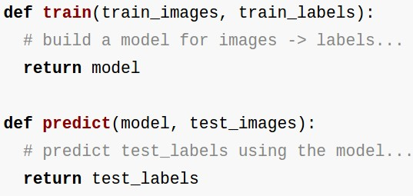
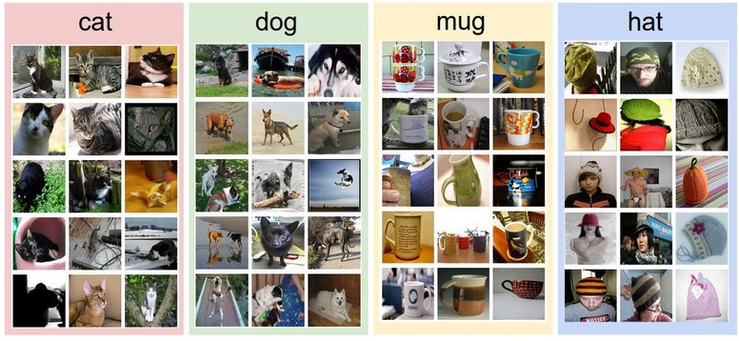
Data-driven approach:
Collect a dataset of images and labels
Use Machine Learning to train an image classifier
Evaluate the classifier on a withheld set of test images
Example training set

Slide 37
First classifier: Nearest Neighbor Classifier
Remember all training images and their labels
Predict the label of the most similar training image

Slide 38
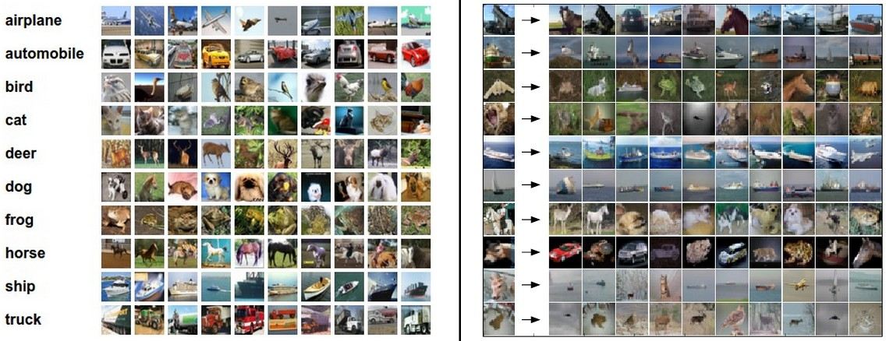
Example dataset: CIFAR-10
10 labels
50,000 training images, each image is tiny: 32x32
10,000 test images.

Slide 39
Example dataset: CIFAR-10
10 labels
50,000 training images
10,000 test images.
For every test image (first column), examples of nearest neighbors in rows

Slide 40
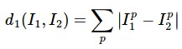
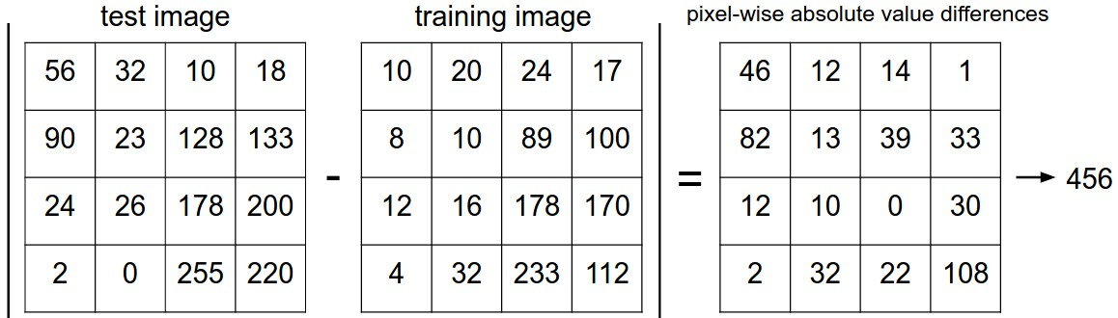
How do we compare the images? What is the distance metric?
L1 distance:
add

Slide 41
Nearest Neighbor classifier

Slide 42
Nearest Neighbor classifier
remember the training data

Slide 43
Nearest Neighbor classifier
for every test image:
find nearest train image with L1 distance
predict the label of nearest training image

Slide 44
Nearest Neighbor classifier
Q: how does the classification speed depend on the size of the training data?

Slide 45
Nearest Neighbor classifier
Q: how does the classification speed depend on the size of the training data? linearly :(
This is backwards:
- test time performance is usually much more important in practice.
- CNNs flip this: expensive training, cheap test evaluation

Slide 46
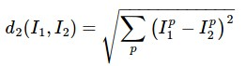
The choice of distance is a hyperparameter
common choices:
L1 (Manhattan) distance
L2 (Euclidean) distance

Slide 47
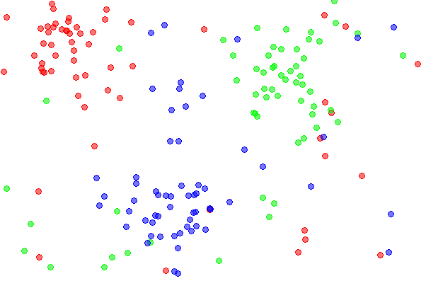
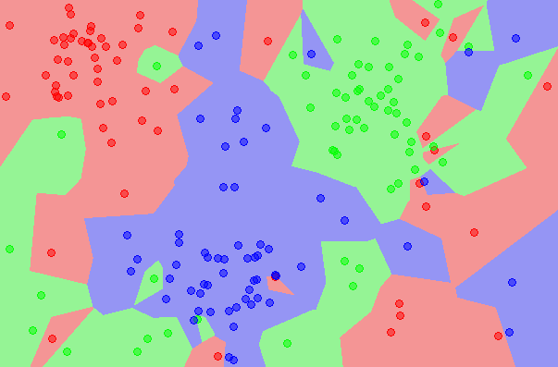
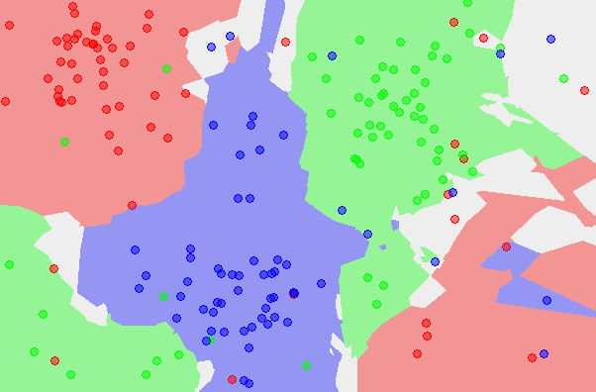
k-Nearest Neighbor
find the k nearest images, have them vote on the label
the data
NN classifier
5-NN classifier
http://en.wikipedia.org/wiki/K-nearest_neighbors_algorithm

Slide 48
Example dataset: CIFAR-10
10 labels
50,000 training images
10,000 test images.
For every test image (first column), examples of nearest neighbors in rows

Slide 49
the data
NN classifier
5-NN classifier
Q: what is the accuracy of the nearest neighbor classifier on the training data, when using the Euclidean distance?

Slide 50
the data
NN classifier
5-NN classifier
Q2: what is the accuracy of the k-nearest neighbor classifier on the training data?

